Slide 1
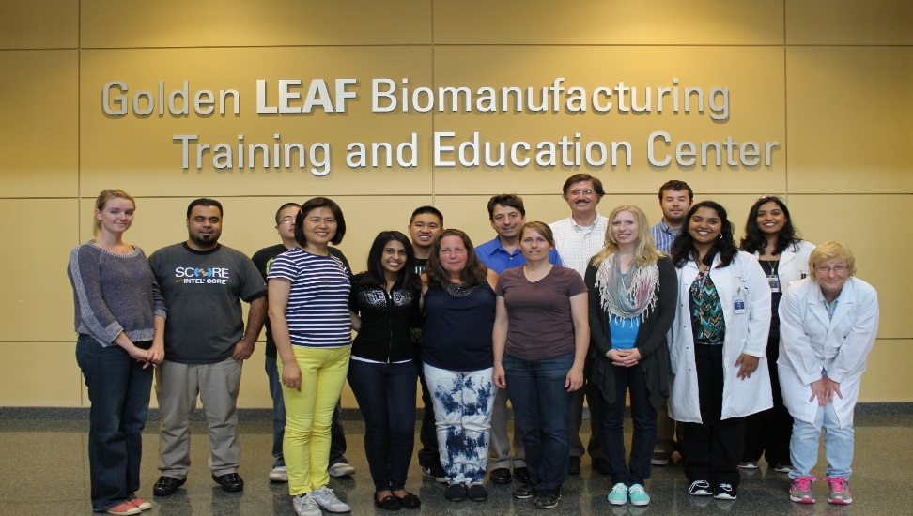



Biosciences Talent Required
Russ H. Read
Indian Congress of Science
January 6, 2016

Slide 2
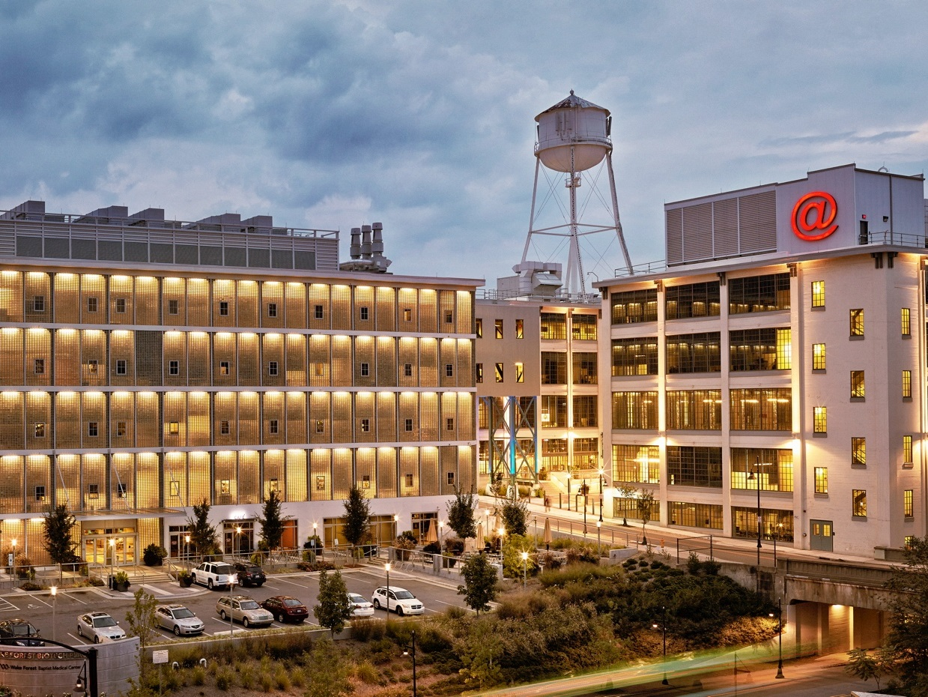

Innovation Quarter
Winston – Salem, NC, USA
works here

Slide 3
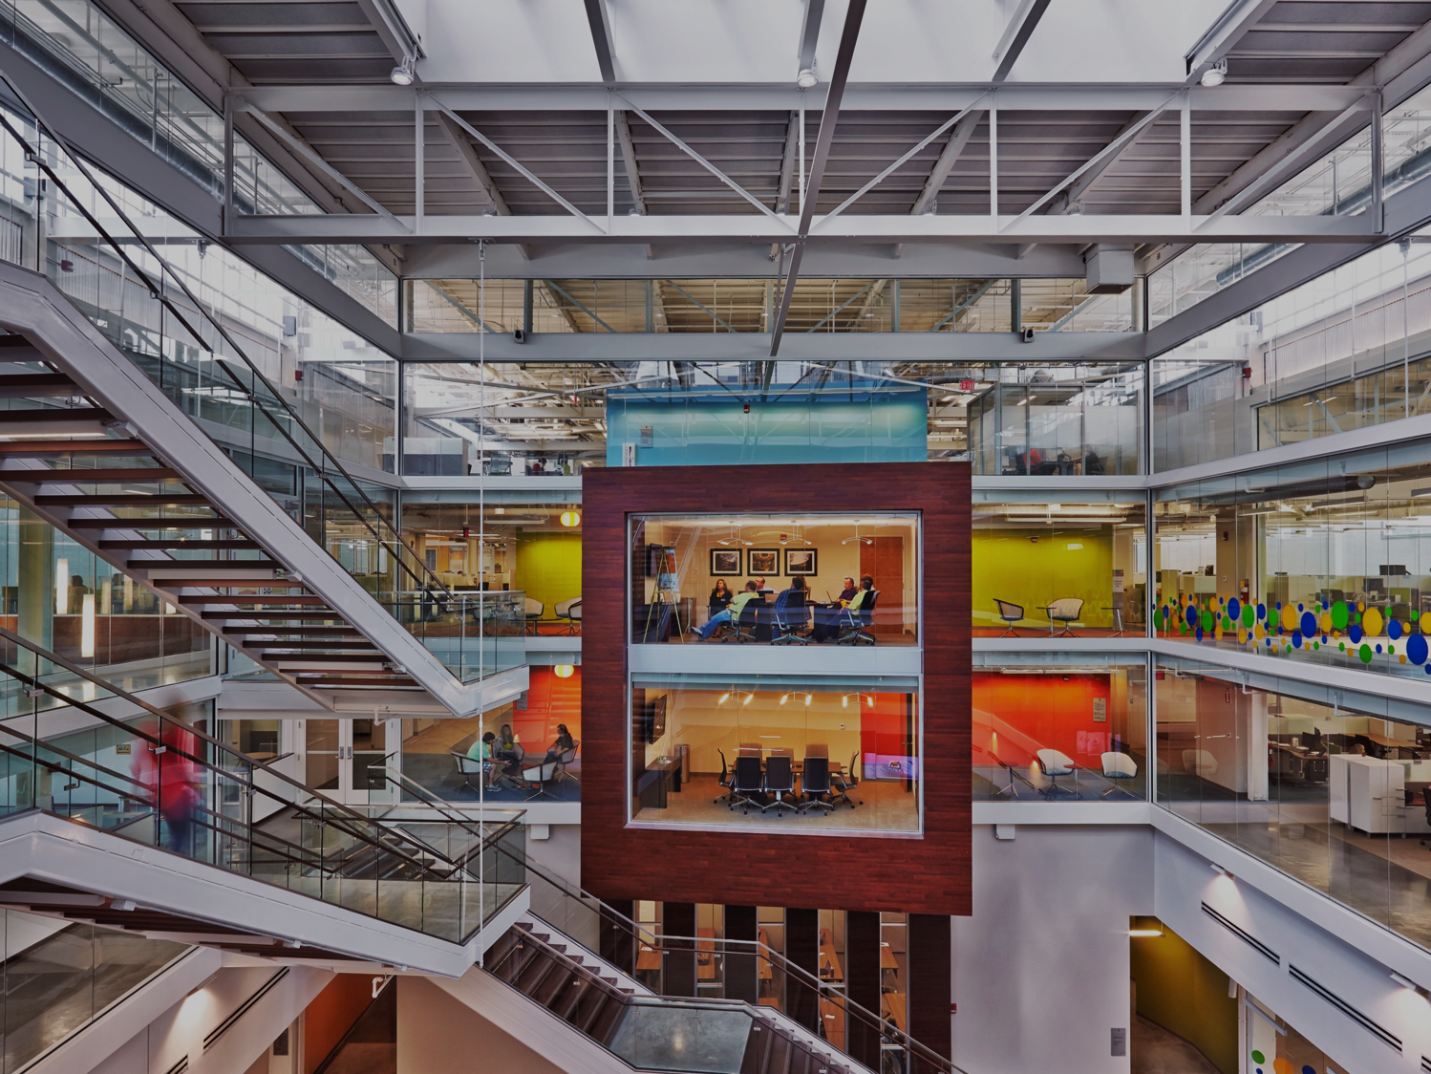
Innovative Workplace
Notes:
Use inside inmar photo here

Slide 4

A Place to Work, Live & Innovate

Slide 5

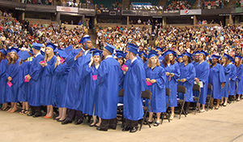
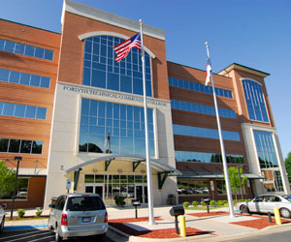
NC Community College System

Slide 6


What we do
Build national partnerships, chase and enact grants, research outcomes
Help create best practices for North Carolina in biosciences training and education

Slide 7
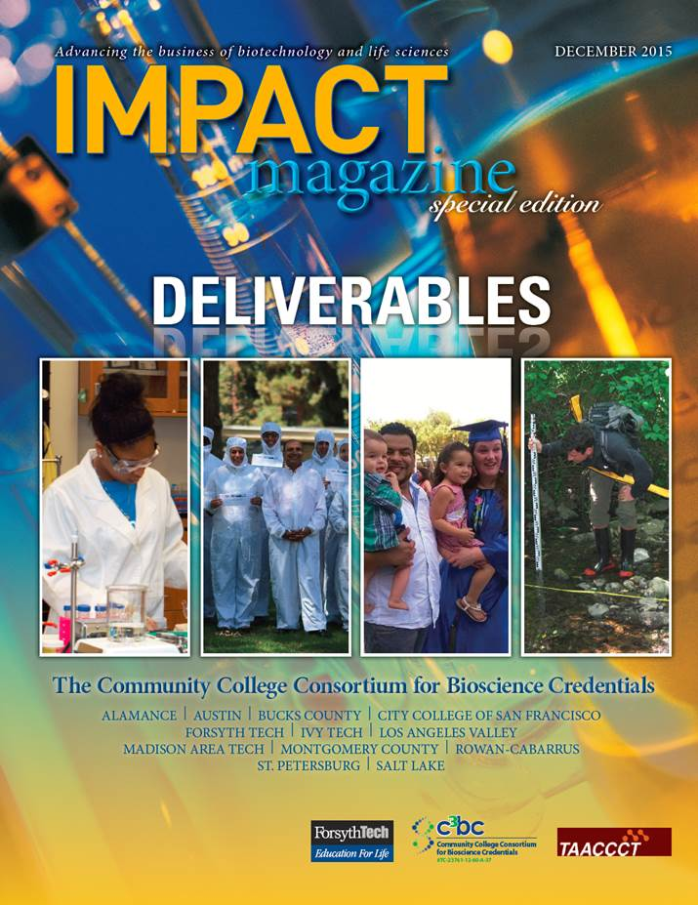


How we do it
Lead the US DOL TAA Consortium for Bioscience (c3bc) & the NSF ATE Biosciences Industrial Fellows Program (BIFP) grants
Outreach & Engagement through the SciTech Lecture Series
http://biotechworkforce.org/

Slide 8

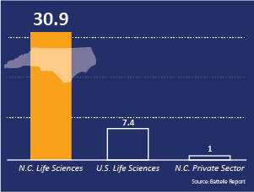
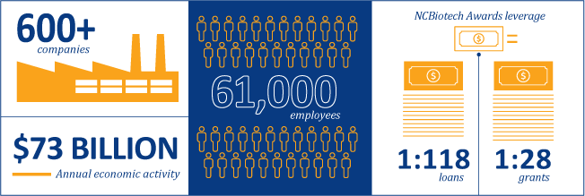
Why is it important to NC?
30.9 percent more jobs from 2000-12
Four times the national average

Slide 9
Building the Future
Home Grown Industry Needs:
Capital
Efficient, effective business environment
Educated manpower

Slide 10

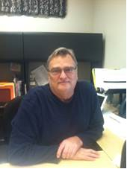
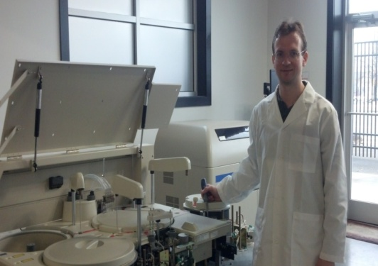
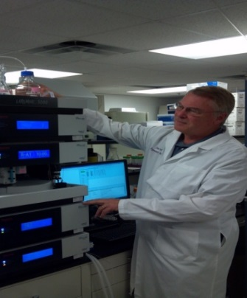
Talent Required* U.S. Bureau of Labor Statistics: www.bls.gov
Scientists, chemists, biologists, pharmacologists, microbiologists, toxicologists, epidemiologists, clinicians, regulatory experts, Biomedical engineers, research associates, technicians, QA/QC experts, manufacturing & production teams, operators packaging, ancillary support, etc.
The demand for qualified Bioscience personnel is increasing in North Carolina & our area - the Piedmont Triad
Our Graduates at Work!

Slide 11
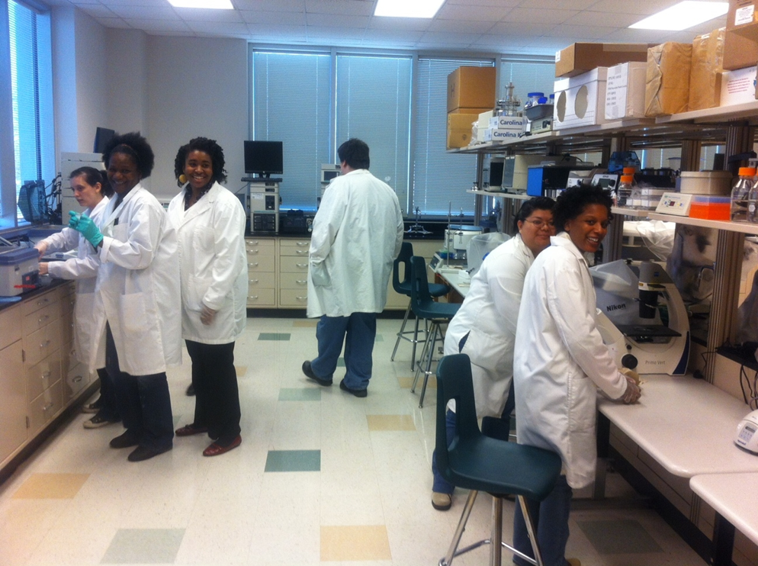

What is in it for Companies?
An increased source of qualified employees

Slide 12


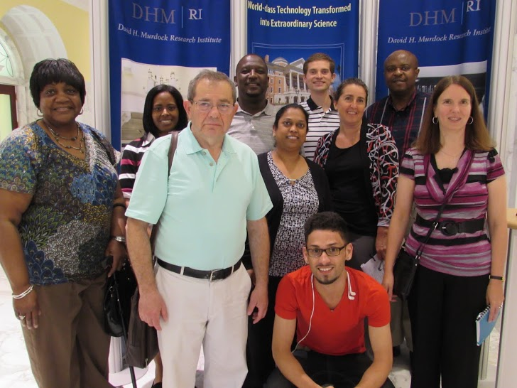
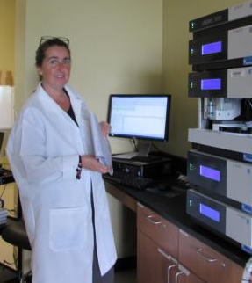
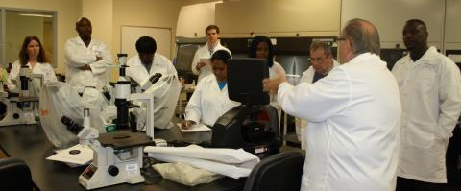
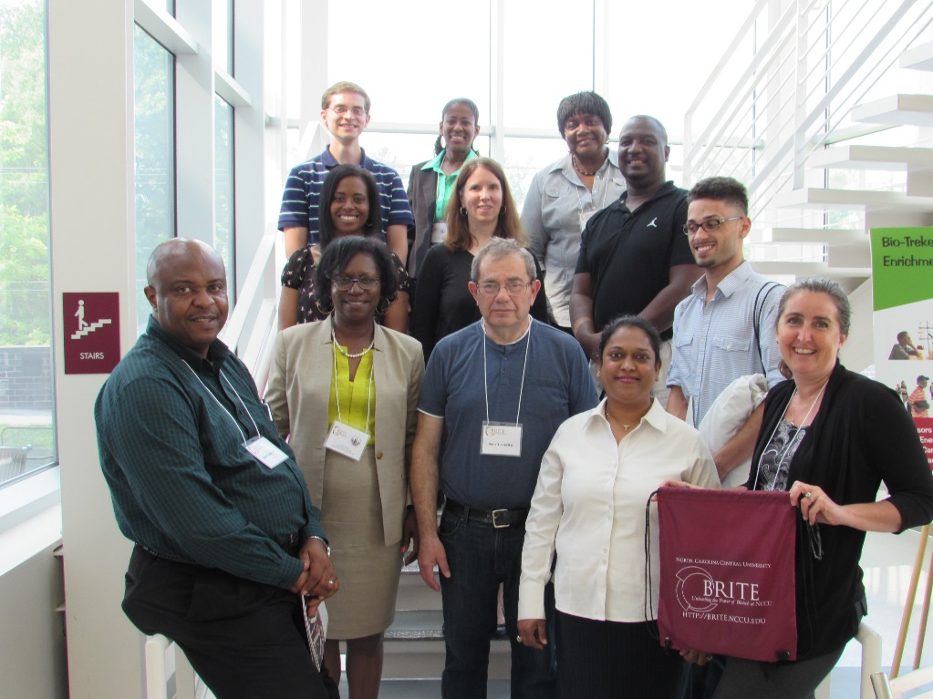
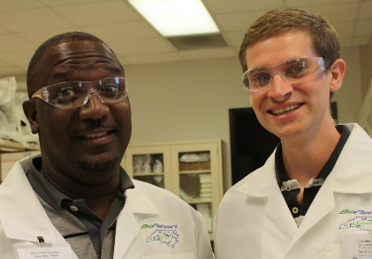
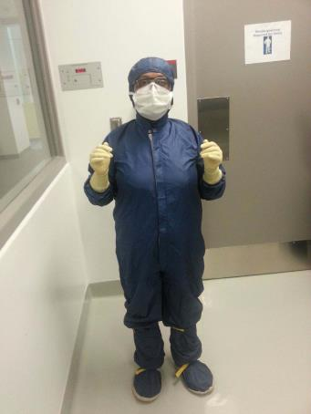
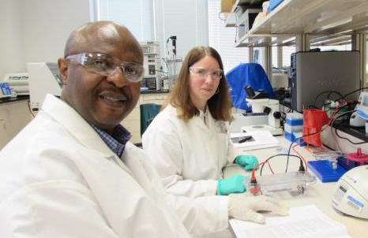



BIFP - One Month Bioscience Industry Fellows Program in NC
Next session June 1-24, 2016

Slide 13

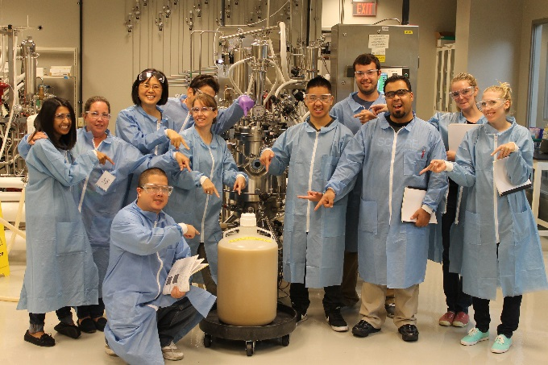
Russ H. Read, Project Director

Slide 14


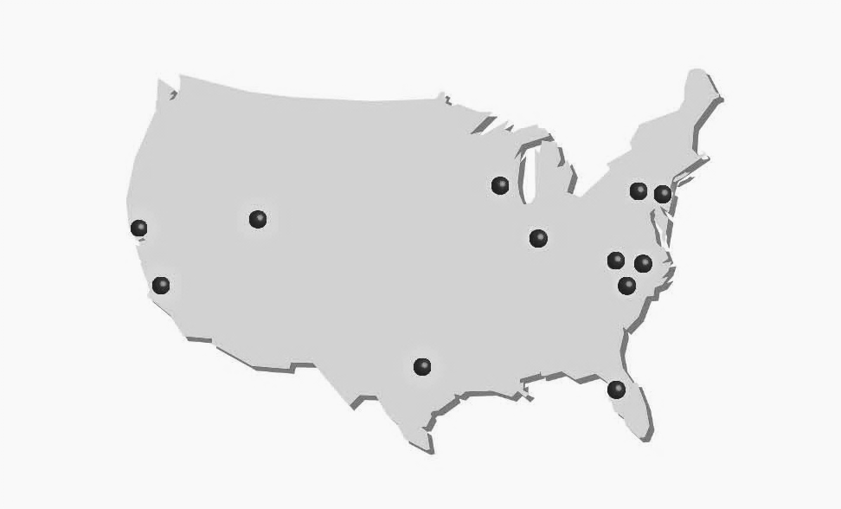
US DOL TAA Grant
$ 14, 998, 474
Recipients : 12 colleges, 8 states
Hubs by color
Lab Skills
Medical Devices
Biomanufacturing
Learning
Status: in Year 4 - Over 3000 in training
http://biotechworkforce.org//ImpactSpecialEdition_12-2015/ImpactMagazineDec.html

Slide 15

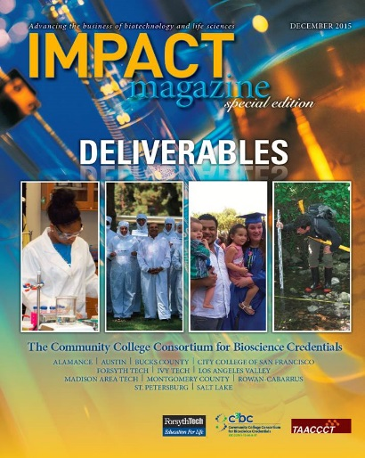
National Approach
Increase capacity by building new programs - credit & short non-credit programs for technicians which is industry needs driven
Build Bioscience Harmonized Skill Standards https://sites.google.com/site/c3bcbioscienceskillstandards/
Remove barriers to achieving training (flexible labs, simulations & gaming programs)
Industry Advisory Committee’s input on credentials & program development
Promote seamless articulations from 2-year schools to 4-year schools = 2+2 and back to 2-year from 4-year schools and beyond for hard skills training
Promote internships (includes a Capstone experience)

Slide 16
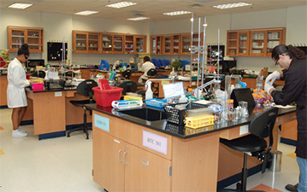

c3bc Learning Technologies Hub
Overview Videos
Modular Learning:
https://www.youtube.com/watch?v=CdqbeqT3woU
Science Skills Lab:
https://www.youtube.com/watch?v=cb9weUeR4xM
Workforce:
https://www.youtube.com/watch?v=n7tFixWy6Tg
Reference: Michael V. Ayers
mayers@forsythtech.edu
Dean of Math, Science, and Technologies
Forsyth Technical Community College
Winston-Salem, North Carolina, USA

Slide 17



Helpful NC Bioscience Resources
http://www.innovationquarter.com/tenants/companies/
http://ncbiotech.org/
http://www.nccommunitycolleges.edu/ncworks-customized-training
http://www.ncbionetwork.org/
http://ncbioscience.net/default.aspx
https://www.bio.org/
http://biotechworkforce.org/
https://www.forsythtech.edu/scienceskillslab/

Slide 18
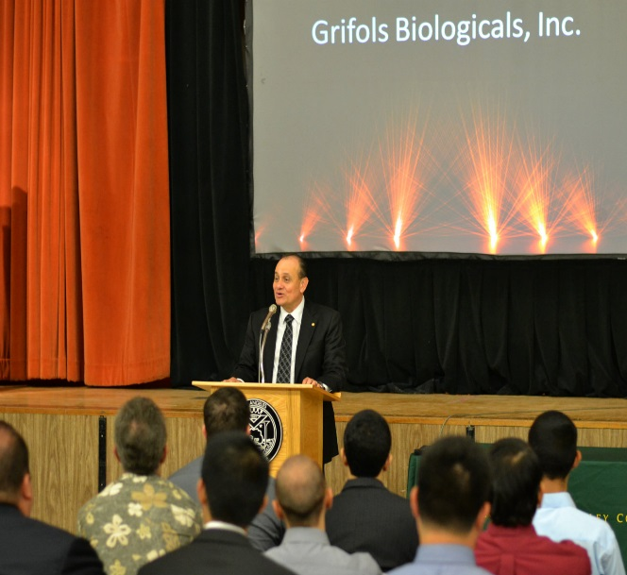
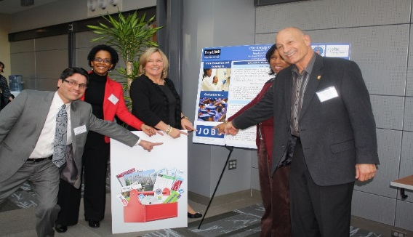


Thank You!
Russ H. Read
Executive Director, NCBW
rread@forsythtech.edu
www.biotechworkforce.org

